Slide 1





CREDIT CARD
TRANSACTION FINANCIAL DASHBOARD
NAME: P SUJITH BATCH NO.: UPOPDM02
REG NO.: U202403014479200

Slide 2
ABSTRACT
This project aims to develop a comprehensive credit card weekly dashboard that provides real-time insights into key performance metrics and trends. The dashboard enables stakeholders to monitor and analyze credit card operations effectively, using Power BI for data visualization and analysis.

Slide 3
INTRODUCTION
The primary objective of this project is to create an interactive dashboard using transaction and customer data from a SQL database. The dashboard provides real-time insights into credit card performance, helping stakeholders make informed decisions.

Slide 4

CONTENTS IN THIS PROJECT
Project objective
Import data to SQL database
Brief about power BI
Advantages of power BI
Advantages compared to other visualization tools
Problem statement
Data description
DAX Queries
Screenshots
Project insights

Slide 5





Project Objective
To develop a comprehensive credit card weekly dashboard that provides real-time insights into key performance metrics and trends, enabling stakeholders to monitor and analyze credit card operations effectively.

Slide 6



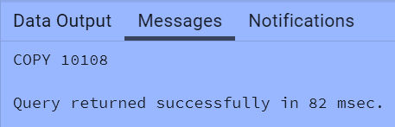

Import data to SQL database
Prepare csv file
Create tables in SQL
import csv file into SQL

Slide 7
BRIEF ABOUT POWER BI
Power BI Overview: Power BI is a data visualization tool that enables users to create interactive dashboards and reports.
DAX: Data Analysis Expressions (DAX) is a library of functions used in Power BI for data manipulation and calculations.
Measures and Calculated Columns: Measures are dynamic calculations used in data analysis, while calculated columns are static and calculated during data import.

Slide 8
ADVANTAGES OF POWER BI
Real-time Data Processing: Power BI allows for real-time data analysis and visualization.
Interactive Dashboards: Users can interact with the data through dynamic dashboards.
Integration: Power BI integrates seamlessly with various data sources like SQL, Excel, and more.

Slide 9
ADVANTAGES COMPARED TO OTHER VISULIZATION TOOLS
Cost-effective: Power BI offers a more affordable pricing model compared to tools like Tableau.
Ease of Use: User-friendly interface that is easy to learn and use.
Advanced Analytics: Provides powerful analytics capabilities with DAX and other advanced functions.

Slide 10
PROBLEM STATEMENT
The need for real-time insights into credit card operations to monitor performance metrics and trends. Traditional reporting methods were not efficient enough to provide timely and actionable insights.

Slide 11
DATA DESCRIPTION
Data Sources: Data was collected from SQL databases, including transaction and customer data.
Data Processing: Data was processed using SQL and DAX queries to create meaningful insights.
Example DAX Queries:
AgeGroup calculation
IncomeGroup calculation
Revenue calculations

Slide 12

DAX Queries
AgeGroup = SWITCH(
TRUE(),
'public cust_detail'[customer_age] < 30, "20-30",
'public cust_detail'[customer_age] >= 30 && 'public cust_detail'[customer_age] < 40, "30-40", 'public cust_detail'[customer_age] >= 40 && 'public cust_detail'[customer_age] < 50, "40-50", 'public cust_detail'[customer_age] >= 50 && 'public cust_detail'[customer_age] < 60, "50-60", 'public cust_detail'[customer_age] >= 60, "60+",
"unknown"
)
IncomeGroup = SWITCH( TRUE(),
'public cust_detail'[income] < 35000, "Low",
'public cust_detail'[income] >= 35000 && 'public cust_detail'[income] <70000, "Med", 'public cust_detail'[income] >= 70000, "High",
"unknown"
)

Slide 13
DAX Queries
week_num2 = WEEKNUM('public cc_detail'[week_start_date])
Revenue = 'public cc_detail'[annual_fees] + 'public cc_detail'[total_trans_amt] + 'public cc_detail'[interest_earned]
Current_week_Reveneue = CALCULATE( SUM('public cc_detail'[Revenue]), FILTER(
ALL('public cc_detail'),
'public cc_detail'[week_num2] = MAX('public cc_detail'[week_num2])))
Previous_week_Reveneue = CALCULATE( SUM('public cc_detail'[Revenue]), FILTER(
ALL('public cc_detail'),
'public cc_detail'[week_num2] = MAX('public cc_detail'[week_num2])-1))

Slide 14
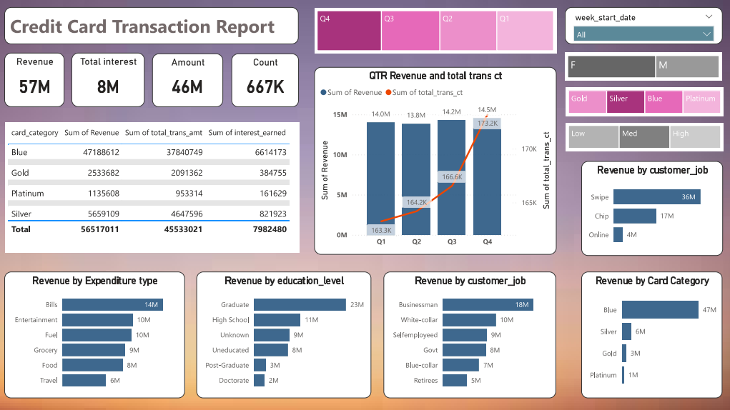
SCREENSHOTS

Slide 15
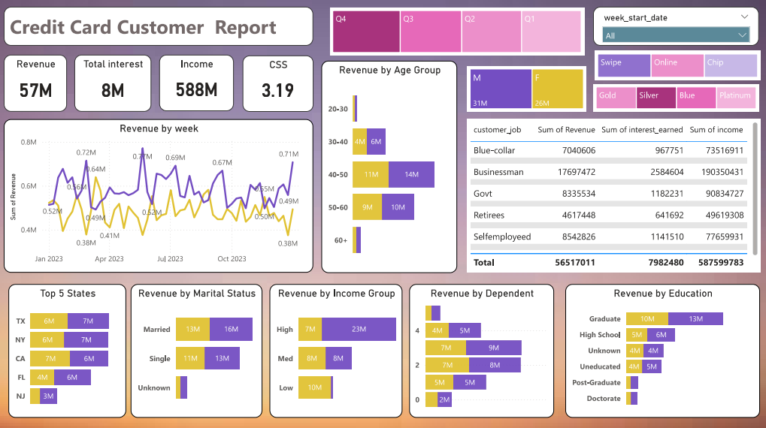
SCREENSHOTS

Slide 16

Project Insights- Week 53 (31st Dec)
WoW change:
Revenue increased by 28.8%,
Overview YTD:
Overall revenue is 57M
Total interest is 8M
Total transaction amount is 46M
Male customers are contributing more in revenue 31M, female 26M
Blue & Silver credit card are contributing to 93% of overall transactions
TX, NY & CA is contributing to 68%
Overall Activation rate is 57.5%
Overall Delinquent rate is 6.06%
Note: You can add more insights

Slide 17
CONCLUSION
Summary: The dashboard provides valuable real-time insights into credit card operations, aiding stakeholders in making informed decisions. The use of Power BI and DAX enhanced the efficiency and effectiveness of data analysis.
Future Work: Potential improvements and future enhancements to the dashboard.

Slide 18


Download Data
GitHub:
https://github.com/Sujith43/-CreditCard_Analytics

Slide 19
THANK YOU

